Slide 1
A Quick Intro to
Git and Github

Slide 2
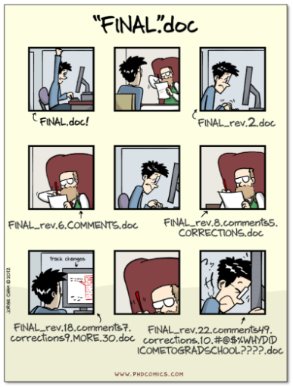

Slide 3
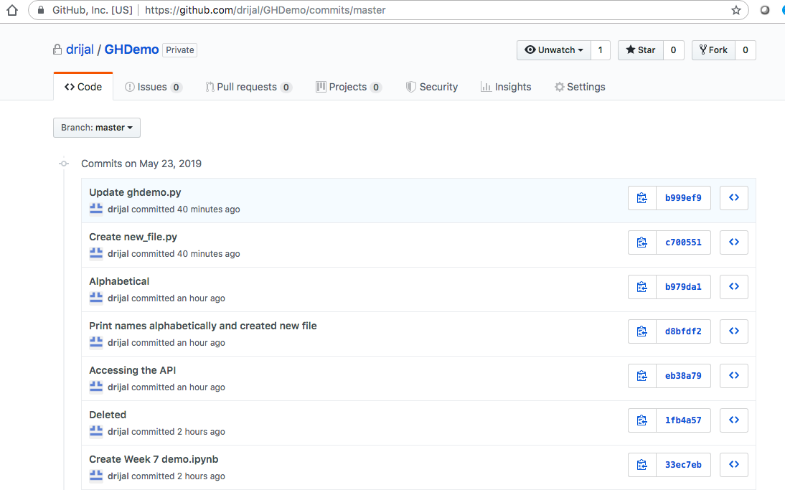
Git
Tracks and manages different versions of files that are part of your project
Each version is called a “commit,” which is a snapshot of the entire working directory, i.e., it records all changes made to the project since last commit
Branches make it possible to have multiple living versions of your files at any time. This allows you to merge branches, compare changes, and decide what to keep and omit.

Slide 4
git commands
  git help
  git status
  git add .
  git commit –m “comment”
  git push
  git pull
  git checkout <branch_name>
  git merge <branch_name>
  git resources: https://git-scm.com/doc

Slide 5
GitHub
A code-sharing platform
Organize and manage contributions to your project (data, code, instructions for use)
GitHub Desktop: Graphical User Interface (GUI) that allows us to use most features of git

Slide 6
Setup and Explore
STEP 1: Create a GitHub.com account if you don’t have one already
STEP 2: Download and Install GitHub Desktop from: https://desktop.github.com/
STEP 3: Log in using GitHub.com account
STEP 4: Clone an existing repository or create a new one
STEP 5: Explore how to: commit changes, push, pull, compare differences between branches, merge, etc.
GitHub Desktop documentation: https://help.github.com/en/desktop/contributing-to-projects

